Slide 1
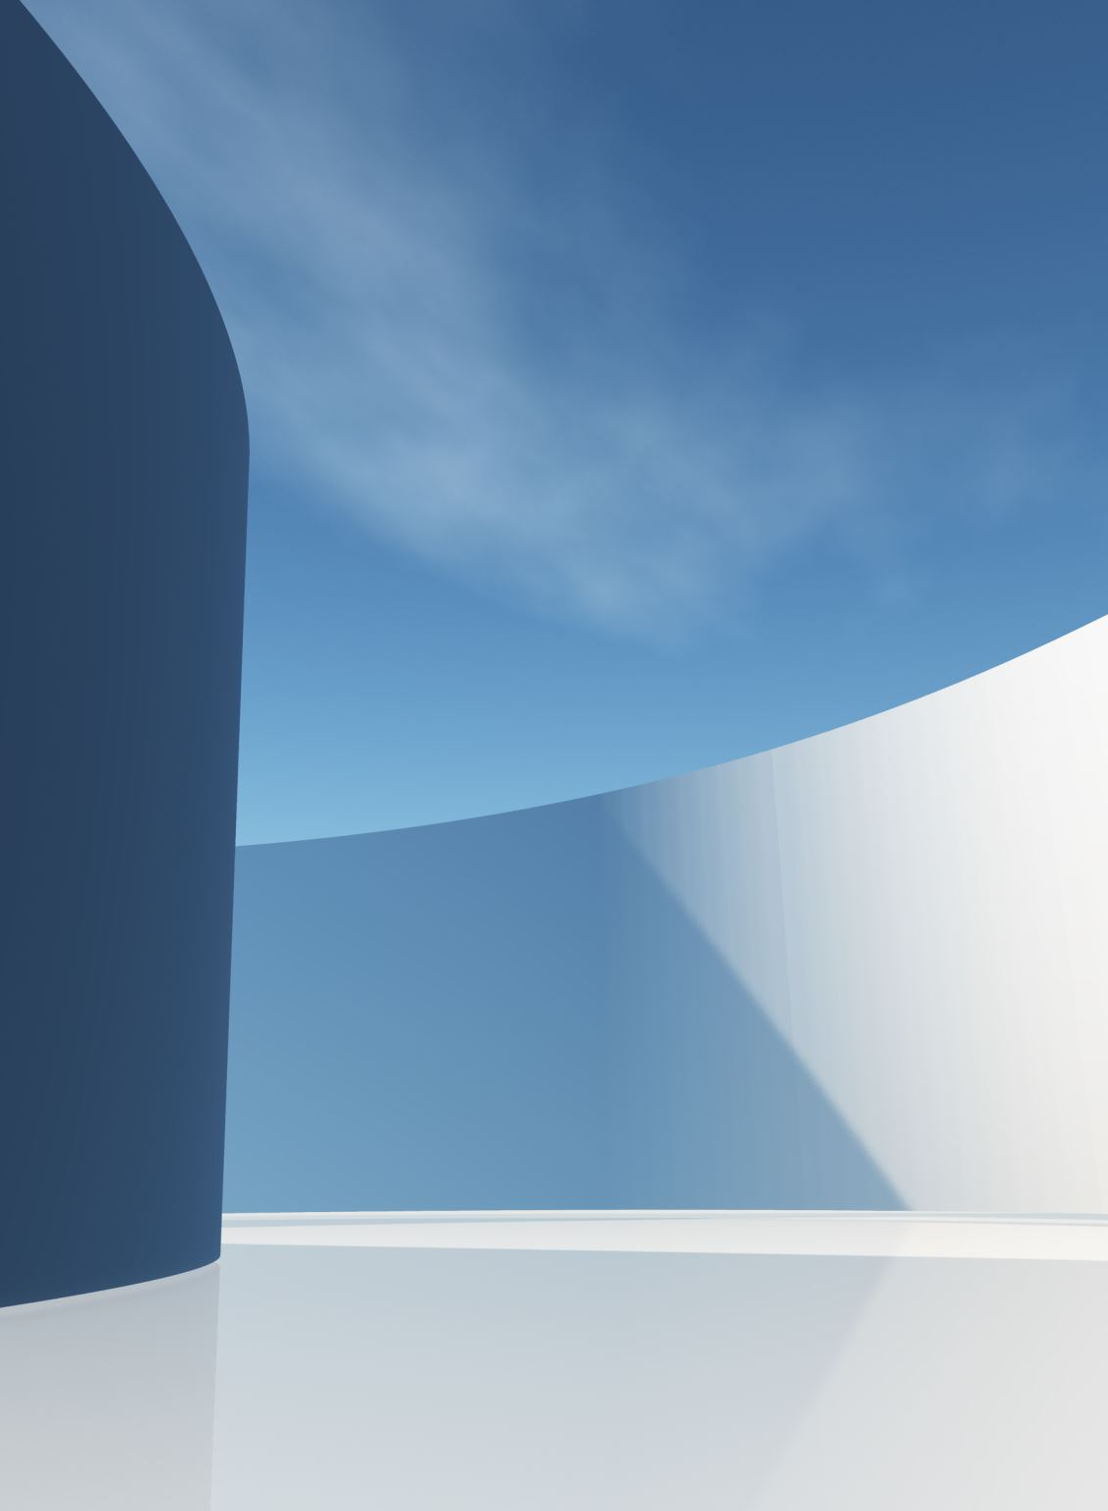
Capstone II House Pricing Factors
Presented by: Riley Lewis

Slide 2
Goal
Analyze the effect of the presence of fireplaces on housing prices.
Analyze the effect of external house materials on housing prices.

Slide 3
Hypotheses
Null Hypothesis 1: The presence of at least one fireplace has no effect on housing prices.
Alternate Hypothesis 1:The presence of at least one fireplace does have an effect on housing prices.
Null Hypothesis 2: The type of external material (wooden vs. other) has no effect on housing prices
Alternate Hypothesis 2: The type of external material (wooden vs. other) does have an effect on housing prices.

Slide 4
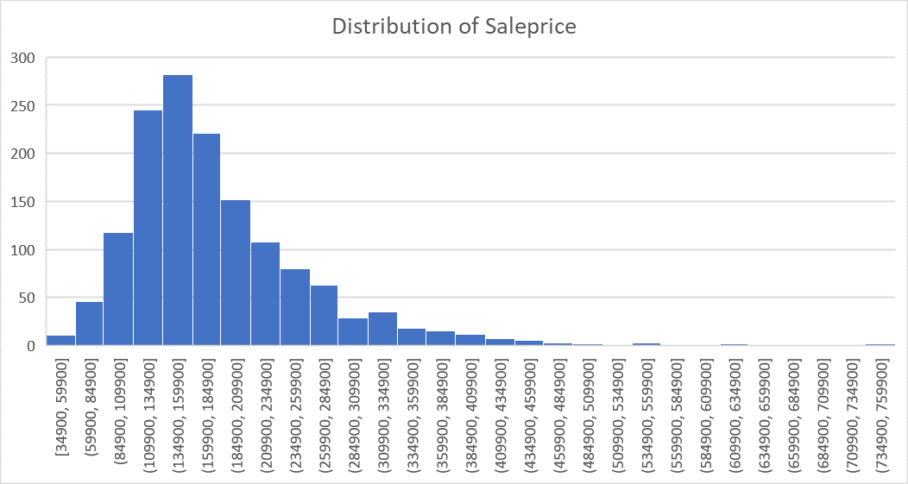
Data
This dataset shows variables that affect (or could affect) housing sale prices in Ames, Iowa. Running descriptive statistics on the SalePrice variable shows it to be a normally distributed continuous variable.

Slide 5
Process
Collect data on both number of fireplaces and type of external material on homes from the housing prices dataset.
Conduct Statistical analyses to see if there is any statistically significant difference between fireplaces to house sale price as well as type of external material to house sale price.

Slide 6
Analysis of fireplaces to sale price
(Reject the Null Hypothesis)
With a 95% certainty there is a significant positive difference of sale price in houses that have at least one fireplace vs. houses with none; given a p Value of 4.63E-84 and a confidence interval of 6978.277

Slide 7
Analysis of type of external material
(The null hypothesis is rejected) With a 95% certainty there is a significant negative difference in houses with wooden external materials vs. houses with other types of external materials; given a p Value of 6.89E-09 and a confidence interval of 8093.077

Slide 8
Conclusion
The statistical analyses showed that:
The presence of at least one fireplace has a significant impact, increasing housing sale prices.
External material has a significant impact on housing prices: houses with wooden external material have lower sale prices compared to houses with other materials.
For reference, analysis workbook is here

